Slide 1
Retirement Income Adequacy and Workplace Pensions
CKME136 Data Analytics: Capstone Course
Melissa Cortina 500928550

Slide 2
Agenda
Research Problem
Dataset
Approaches
Analysis of Occupation Type and Industry Type
Classification Algorithms
Association Rules
Conclusions

Slide 3
Research Problem
Retirement income ≈ 70% of your salary in last year of employment
Made up of 3 sources:
government-sourced pensions
annuities from personal savings
workplace pension

Slide 4
Research Problem continued
Pension Plan goal: remain fully funded
One method, increase enrollments into the pension plan
OBJECTIVE: Target industries without workplace pension plans and enroll the best candidates to support future retirees and the sustainability of a pension plan

Slide 5
Dataset
Survey of Labour and Income Dynamics (SLID), 2011 [Canada]: Person File
Statistics Canada
Collection of income, labour and family variables on persons in Canada
Stratified, multi-stage design that uses probability/random sampling

Slide 6
Dataset continued
Complete dataset:
47,705 instances and 147 attributes
Filtered attribute “alfst28” - person’s annual labour force status
26 attributes chosen for relevance to topic
9 quantitative attributes and 17 qualitative attributes
Some include: industry code, number of years of experience, highest level of education

Slide 7


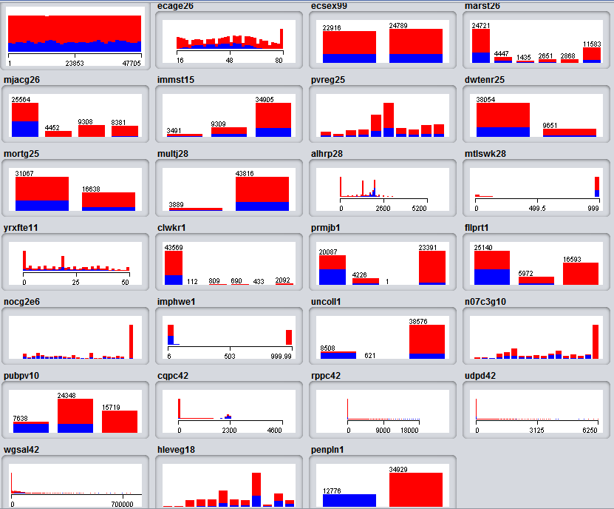



Dataset continued

Slide 8
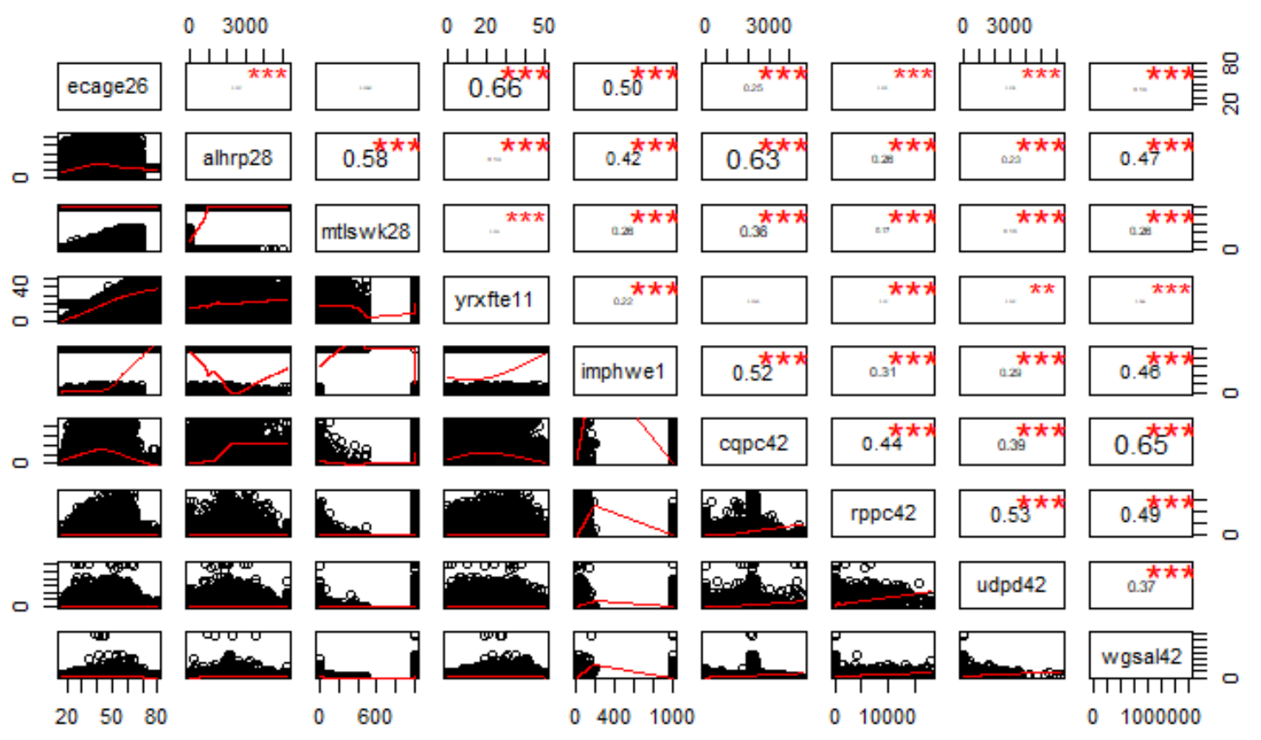
Dataset continued

Slide 9
Dataset continued
“Dummy” data:
Numerical codes, usually 97, 98, and 99
No null entries
Sufficient data
Replaced with mean or mode
3 attributes removed: immst15, mtlswk28, and mjacg26

Slide 10
Approaches
Three approaches:
1) Analysis of Occupation Type and Industry Type
2) Classification Algorithms
3) Association Rules

Slide 11
1) Analysis of Occupation Type

Slide 12
1) Analysis of Industry Type

Slide 13
2) Classification Algorithms
Supervised learning
10-fold cross validation
1) J48 Decision Tree
2) Naïve Bayes
3) K-Nearest Neighbours (“KNN”) (K = 24)

Slide 14
2) Classification Algorithms
 | J48 Decision Tree | Naïve Bayes | KNN (K = 24)
True Positive Rate (Recall) | 0.790 | 0.846 | 0.777
False Positive Rate | 0.125 | 0.189 | 0.101
Precision | 0.863 | 0.817 | 0.885
ROC Area | 0.837 | 0.920 | 0.926
Accuracy | 83.2516% | 82.8310% | 83.8365%
Correctly Classified Instances | 27,161 | 27,024 | 27,352

Slide 15
3) Association Rules
Apriori Algorithm
Minimum support = 0.1
Confidence level = 0.9
Number of rules = 10
7 cycles

Slide 16
3) Association Rules
Best rules found:
1. multj28=2 prmjb1=1 9512 ==> fllprt1=1 8788
2. prmjb1=1 10504 ==> fllprt1=1 9647
3. mortg25=1 9728 ==> fllprt1=1 8924
4. dwtenr25=1 multj28=2 9732 ==> fllprt1=1 8901
5. multj28=2 11493 ==> fllprt1=1 10494
6. prmjb1=1 fllprt1=1 9647 ==> multj28=2 8788
7. dwtenr25=1 fllprt1=1 9795 ==> multj28=2 8901
8. dwtenr25=1 10799 ==> fllprt1=1 9795
9. fllprt1=1 11570 ==> multj28=2 10494
10. prmjb1=1 10504 ==> multj28=2 9512

Slide 17
Conclusions
Occupation to target: Sales
Industry to target: Trades
KNN (K = 24) best model to determine good candidates to be enrolled
Apriori: best candidates are fulltime and do not work multiple jobs throughout the year

Slide 18
Thank you

